Slide 1
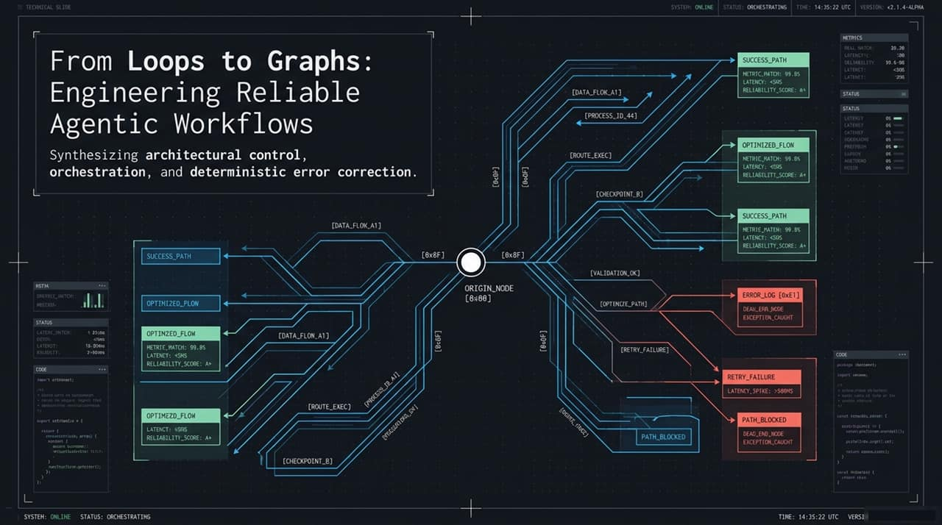
Notes:
Welcome everyone. Today, we're discussing the architectural shift in AI system design: moving From Loops to Graphs.
Over the last year, many teams rushed to deploy autonomous agents using basic ReAct loops. While impressive in demos, production systems quickly revealed a harsh truth: open-ended loops lack the architectural constraints required for high reliability.
In this talk, we’ll look at how Graph Engineering bridges the gap—combining architectural control, multi-state orchestration, and deterministic error correction to build agentic workflows that scale reliably in production environments.

Slide 2
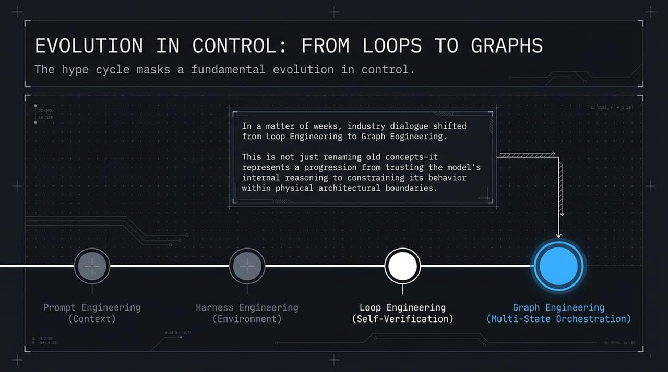
Notes:
Look at how rapidly our control paradigms have evolved:
Prompt Engineering: We began by engineering context—trying to guide the model purely via system prompts.
Harness Engineering: We built external execution environments, supplying APIs, tools, and sandboxes.
Loop Engineering: We introduced self-verification, prompting the model to evaluate its own output in iterative cycles.
Graph Engineering: Today’s state of the art—multi-state orchestration.
This transition isn't just semantic. It marks a fundamental shift: we are moving away from trusting an LLM’s internal reasoning and toward constraining its behavior within physical architectural boundaries.

Slide 3
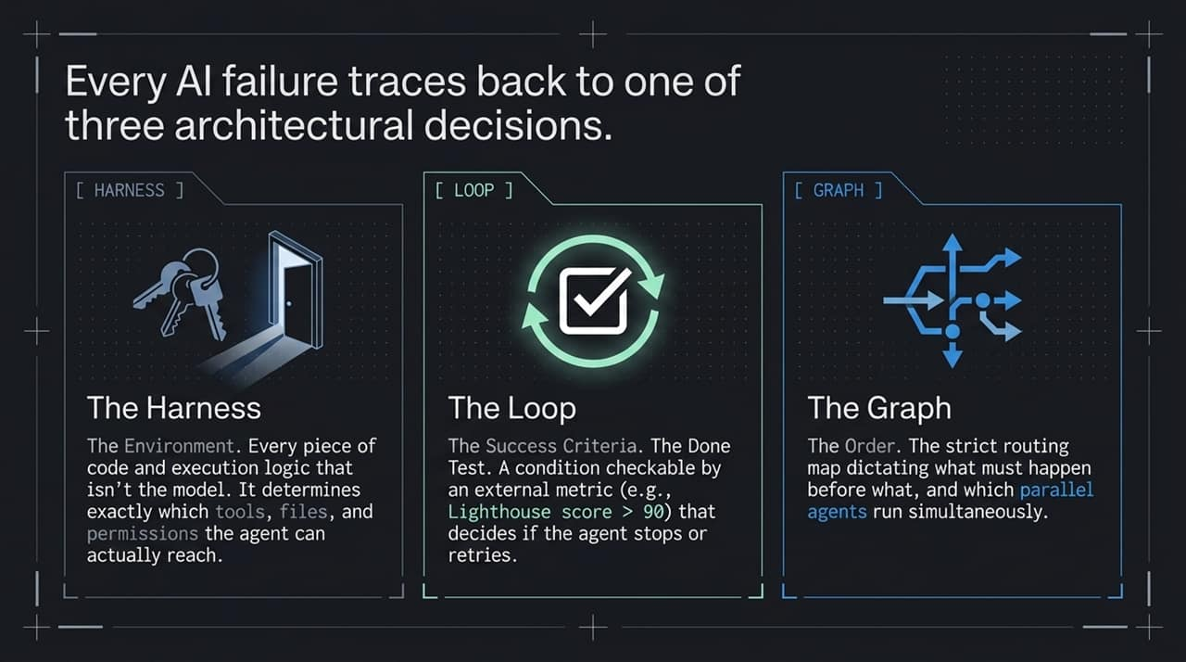
Notes:
When an agent fails in production, it is rarely a 'random model hallucination.' Almost every failure stems from one of three structural components:
The Harness (Environment): Everything outside the model—the sandbox, permissions, and tool interfaces. If an agent accesses the wrong directory or lacks API credentials, it's a harness failure.
The Loop (Success Criteria): The 'Done Test'. A deterministic, checkable condition (e.g., unit test pass rate or benchmark score) that tells the agent whether to stop or retry.
The Graph (Order & Routing): The execution map. It defines which tasks execute sequentially, which run in parallel, and how control transfers between sub-agents.
Isolating your failure modes across these three boundaries makes debugging systematic rather than guesswork.

Slide 4
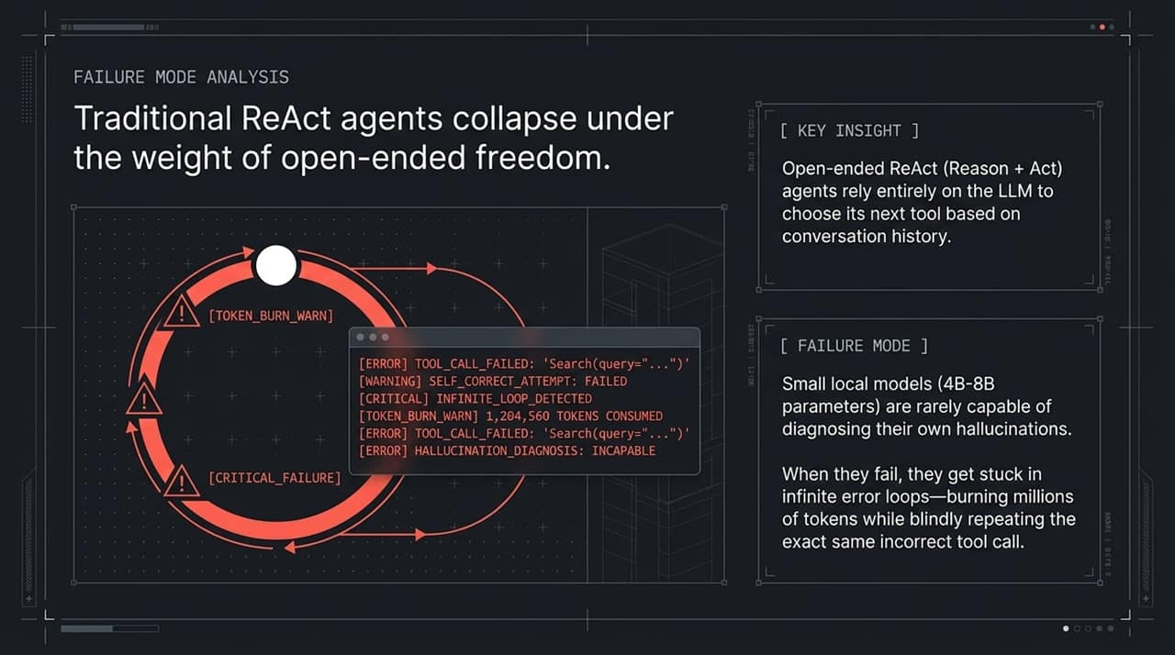
Notes:
Let’s look at a concrete example of open-ended ReAct failure. In a traditional setup, the LLM inspects its history and picks the next tool on its own.
When using smaller local models—say in the 4B to 8B parameter range—they struggle to self-diagnose hallucinations or runtime exceptions.
The result? An infinite error loop. The model calls a failing search query, receives an error, attempts to self-correct, calls the exact same query, and repeats. As shown on screen, you end up consuming over 1.2 million tokens on a dead end. Graphs prevent this by enforcing maximum retries, fallback routes, and deterministic state transfers.

Slide 5
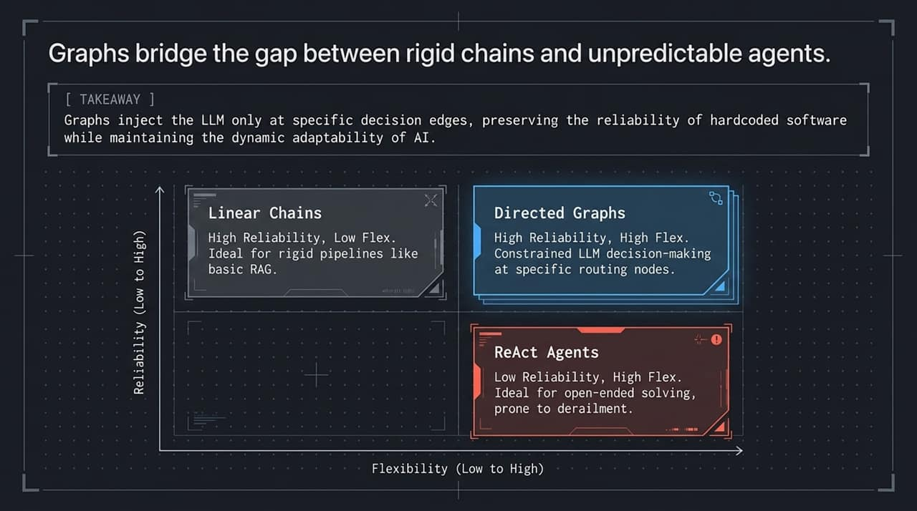
Notes:
Architectural choice is a trade-off between reliability and flexibility:
Linear Chains: High reliability, low flexibility. Perfect for standard RAG pipelines, but rigid when dealing with ambiguous tasks.
ReAct Agents: High flexibility, low reliability. Great for unconstrained problem-solving, but prone to structural derailment.
Directed Graphs: The sweet spot. You get high reliability and high flexibility.
Instead of giving the model a blanket blank canvas, graphs inject the LLM only at specific routing edges. Code handles the execution backbone; the LLM handles decision routing where flexibility is actually needed.

Slide 6
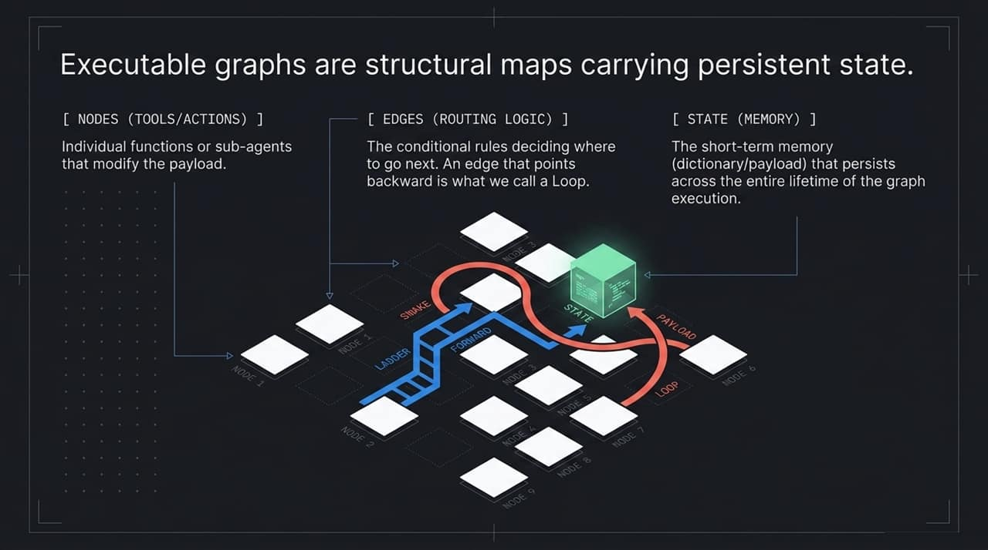

Slide 7
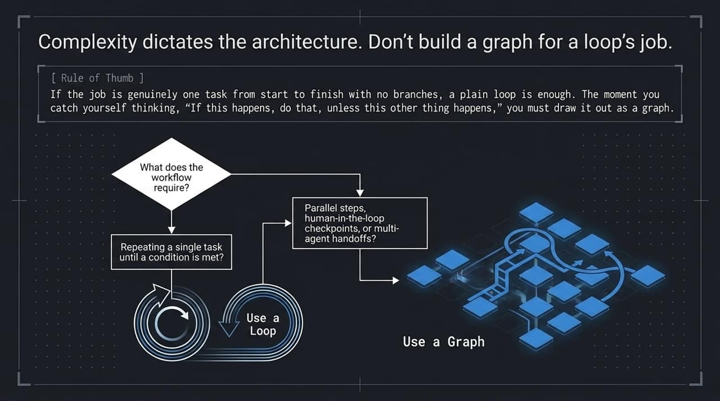
Notes:
A practical rule of thumb for engineering teams: Don't over-engineer simple tasks.
If a task is sequential, single-pass, or simply repeats until a single evaluation metric is met, keep it as a plain loop.
However, the moment your design logic sounds like: 'If step A succeeds, go to B; if it fails, retry with tool C; if parallel checks pass, hand off to Agent D', you have outgrown a loop. That requires a graph.

Slide 8
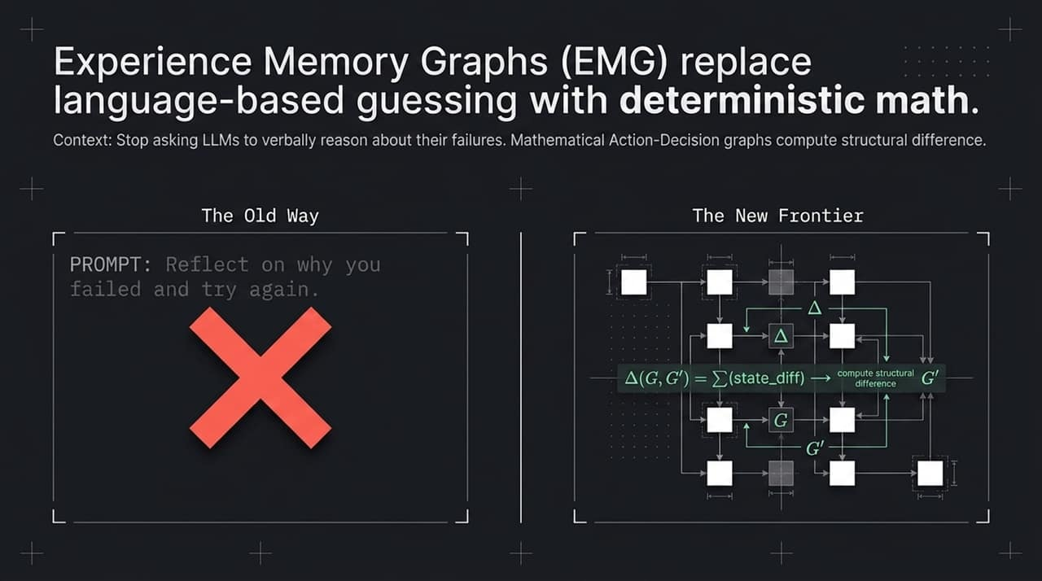
Notes:
Now let's dive into self-correction.
The Old Way: Appending 'Reflect on why you failed and try again' to the prompt context. LLMs are notoriously poor at self-reflecting on their own active context traces—it often leads to confirmation bias or repeated errors.
The New Frontier: Experience Memory Graphs (EMG). Instead of asking the model to chat about its errors, we convert execution traces into formal Directed Action-Decision Graphs. We then compute the structural mathematical difference—$\Delta(G, G')$—between the failed trajectory ($G$) and known expert trajectories ($G'$).

Slide 9
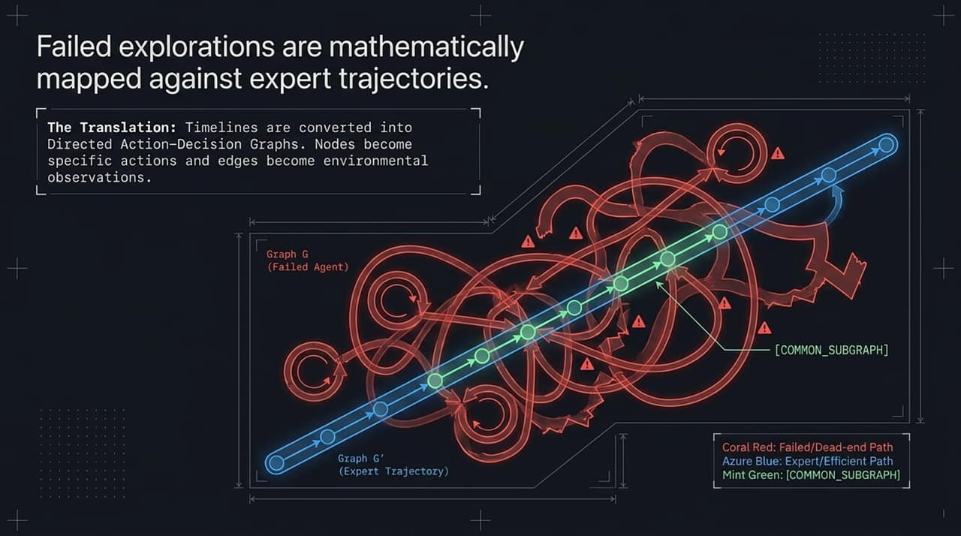
Notes:
"Here is how mathematical trajectory alignment works visually.
The coral red path represents a failed run. Notice how the agent meanders, loops back on itself, hits dead-end nodes, and burns tokens. The azure blue path represents an efficient, successful expert trajectory.
By representing both runs as directed graphs, we isolate the exact point where the agent diverged from the expert path (shown as the mint green common sub-graph). We don't rely on prompt intuition; we locate structural divergence using graph math.

Slide 10
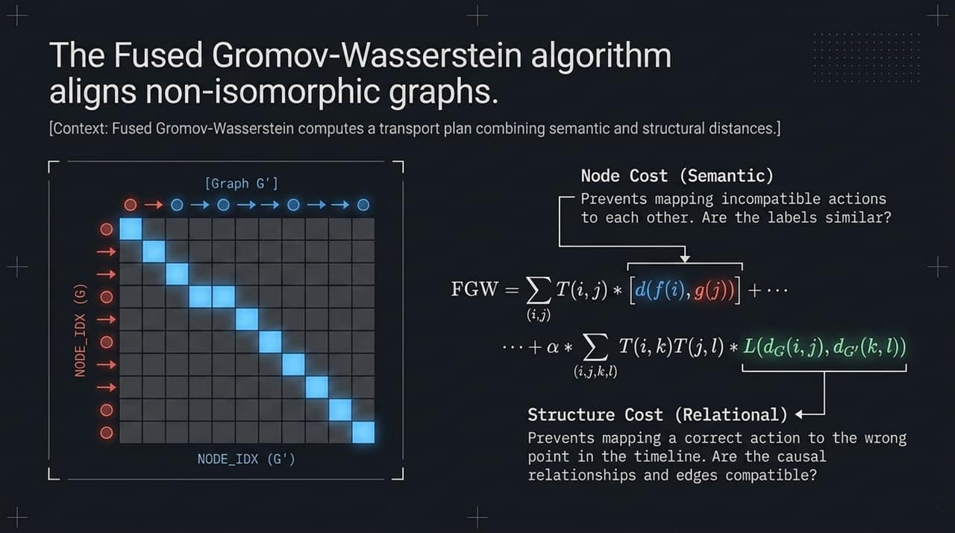

Slide 11
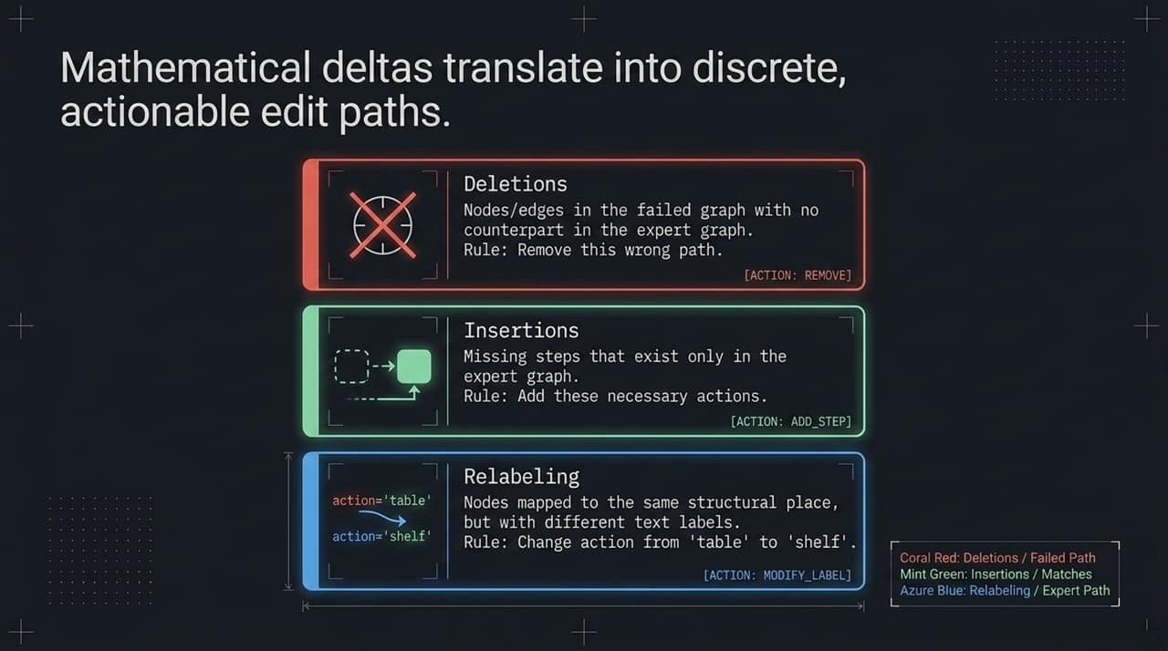
Notes:
Once Fused Gromov-Wasserstein calculates the optimal transport plan, how do we actually apply that to fix our AI agent? We convert the mathematical delta directly into discrete, actionable edit paths.
Think of this like a git diff for agentic behavior:
Deletions ([ACTION: REMOVE]): These represent nodes or edges in the agent's failed run that have no counterpart in the expert trajectory. If an agent gets stuck in a search loop or executes an unnecessary API call, the system explicitly flags that path to be removed.
Insertions ([ACTION: ADD_STEP]): These are critical missing steps present only in the expert trajectory—for instance, running a validation check before executing a database write. The edit path injects this required step.
Relabeling ([ACTION: MODIFY_LABEL]): This occurs when the agent takes an action in the right place within the sequence, but with the wrong parameter or intent—such as querying a 'table' node instead of a 'shelf' node.
Instead of handing the model a long, unstructured block of text saying 'Please try to do better,' we give the orchestration framework a precise, structural diff that physically re-routes or re-instructs the workflow.

Slide 12
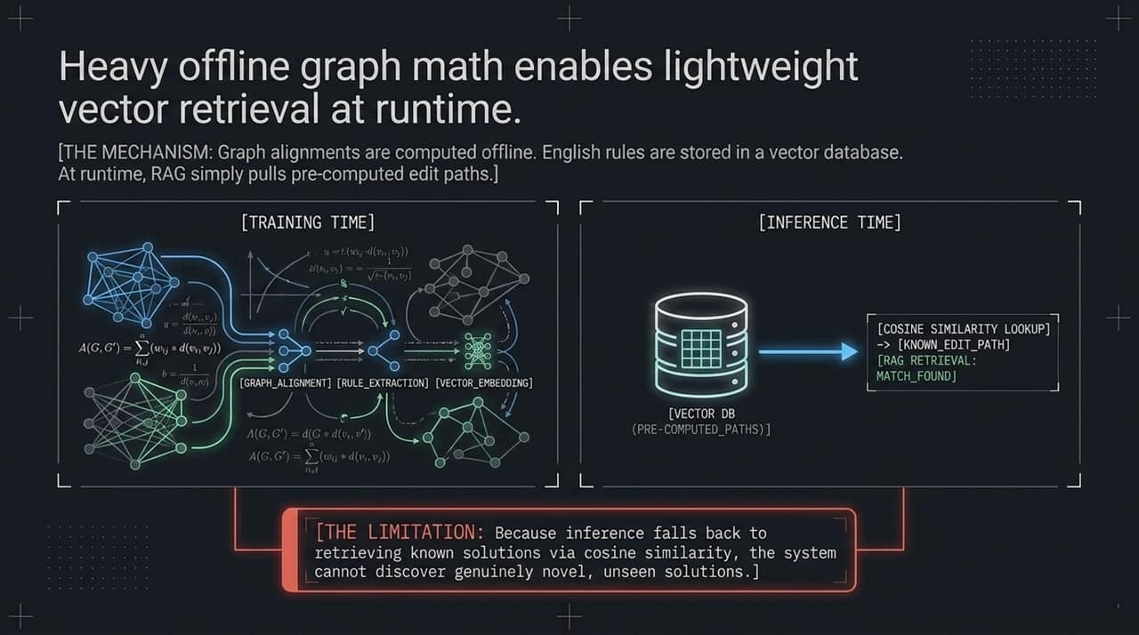
Notes:
Now, you might be asking: 'Calculating Fused Gromov-Wasserstein alignments for every single execution sounds computationally expensive. How does this scale in real-time production systems?'
The secret lies in decoupling offline graph math from runtime execution.
During Training / Offline Processing, we perform the heavy lifting. We analyze thousands of agent runs, compute structural graph alignments, extract the human-readable edit rules, and index those rules into a Vector Database as embeddings.
At Inference / Runtime, the agent doesn't re-run expensive graph algorithms. Instead, when an error state occurs, it performs a fast vector search—a simple Cosine Similarity Lookup—to pull the pre-computed edit path that matches its current failure pattern.
Important Caveat / Trade-off: Because real-time execution relies on pulling known pre-computed solutions via RAG, the system is exceptionally fast and deterministic, but it cannot discover genuinely novel solutions on the fly. It excels at turning past failures into immediate, reliable execution paths, but relies on your offline pipeline to continually ingest and map new edge cases.

Slide 13
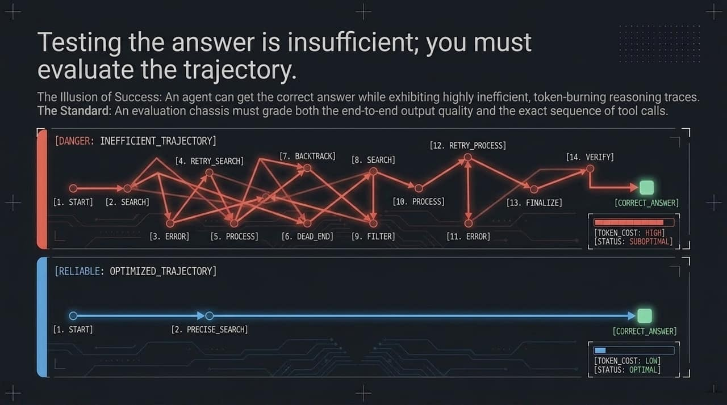
Notes:
In traditional software, if an automated test returns the expected output, the test passes. In agentic AI, testing the final answer is completely insufficient; you must evaluate the trajectory.
Take a look at these two execution paths on the slide. Both arrive at the exact same correct answer.
In the top path, the agent stumbles through 14 chaotic steps—retrying searches, hitting dead ends, backtracking, and consuming over a million tokens. To a basic evaluator checking only the final response, this looks like a 'Success.' In reality, it’s a ticking time bomb of latency, API cost, and probabilistic drift.
In the bottom path, the agent takes two direct, precise steps to reach the result at minimal token cost.
If your evaluation harness only looks at end-state accuracy, you will deploy systems that burn through budgets and introduce hidden failures. True agent reliability requires grading both the end-to-end output quality AND the exact sequence of tool calls.

Slide 14
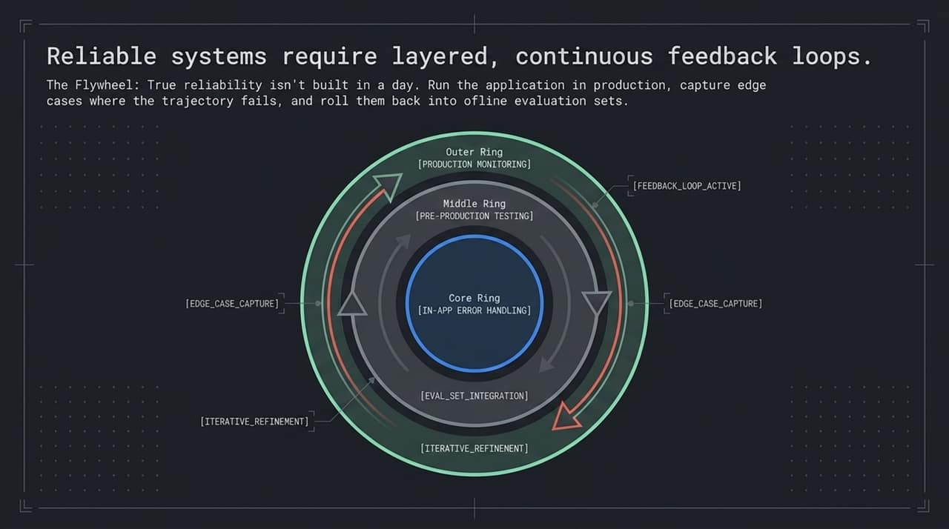
Notes:
Reliability isn't something you ship once and forget—it's an engineering flywheel built on continuous feedback loops. We structure this across three concentric layers:
Core Ring (In-App Error Handling): This is your immediate frontline defense. Deterministic guardrails, schema validators, and local fallback paths catching basic syntax or tool invocation errors in real-time.
Middle Ring (Pre-Production Testing): Before any prompt, node, or routing edge goes live, it must run against offline evaluation datasets containing previously captured edge-case trajectories.
Outer Ring (Production Monitoring & Feedback): When an agent encounters an unmapped edge case in production, the trace is logged, flagged, and automatically fed back into your offline dataset.
As production logs feed the offline alignment algorithms, your vector store of edit paths grows richer, making the whole system progressively more resilient over time.

Slide 15
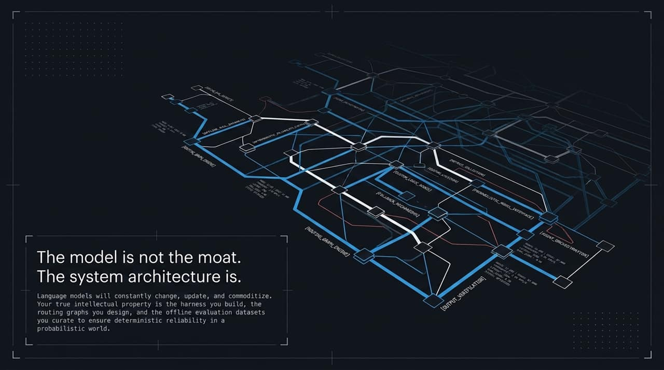
Notes:
If you take away one strategic lesson from today, let it be this: The model is not your moat. Your system architecture is.
Base LLMs are rapidly becoming commoditized. Models will change, providers will shift, and weights will update every few months. If your application's reliability depends entirely on a specific model's internal reasoning, your IP is fragile.
Your true intellectual property lies in:
The harness you build to enforce execution rules,
The routing graphs that constrain state transitions, and
The curated evaluation datasets and memory graphs that guarantee deterministic execution on top of probabilistic models.
Models provide the raw intelligence; engineering architectures provide the enterprise-grade reliability.

Slide 16
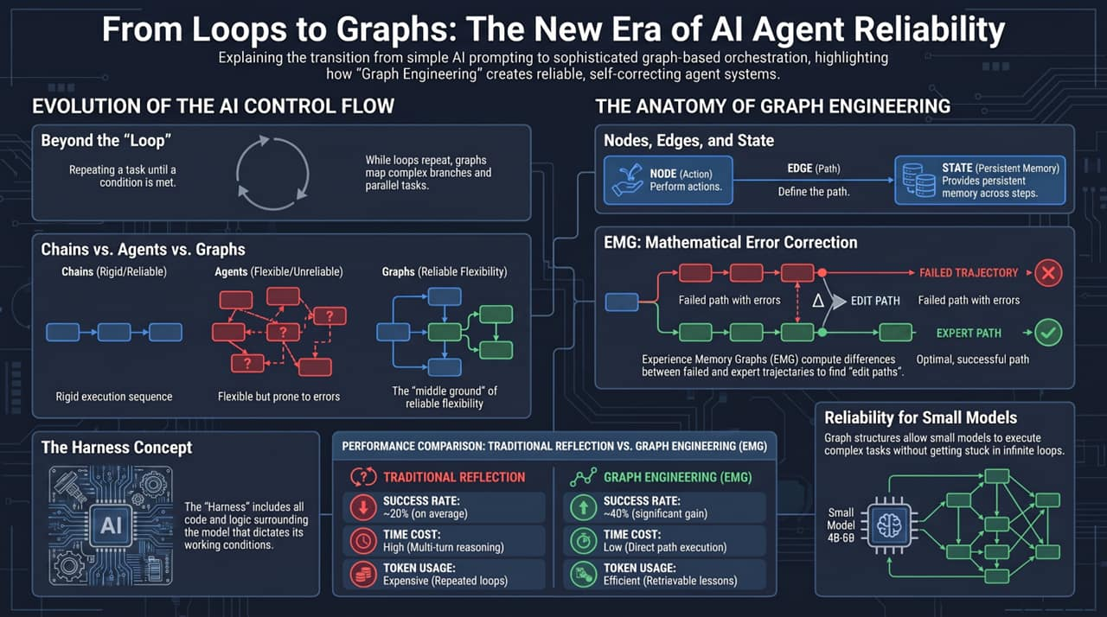
Notes:
To wrap up our discussion, let's contrast traditional agentic patterns with the Graph Engineering paradigm across real-world performance metrics.
Under Traditional Reflection (the standard 'ReAct' loop where we ask the LLM to read its error log and reflect), performance drops sharply as task complexity rises:
Success Rates hover around 20% on complex, multi-step benchmark tasks.
Latency and Costs spike dramatically because the model engages in multi-turn verbose reasoning loops, burning tokens repeatedly without guaranteeing convergence.
By switching to Graph Engineering with Experience Memory Graphs (EMG):
Success Rates double to ~40%+ on standard benchmark suites—especially when using smaller, cost-effective open-source models (e.g., 4B to 8B parameter models) that typically struggle with self-reflection.
Time Costs drop from high multi-turn latency to direct, single-pass path execution.
Token Consumption is optimized, because the model is retrieving deterministic edit actions rather than trying to reason its way out of hallucinated loops.
By structuring workflows around Nodes for actions, Edges for conditional routing, State for memory, and a strict Harness for execution, we transition from fragile AI experiments to predictable, scalable enterprise software.

